Slide 1


RESEARCH PROPOSAL
Modulating Moral Judgment: Exploring Effects of Transcranial Direct Current Stimulation (tDCS) on Prefrontal Cortex
CCBS7002 Cognitive Neuroscience

Slide 2




The Research Team
Chan, Natalia MC364341 | Xiao, Xinyun MC364492 | Liu, Yuqi MC364124
Notes:
不是，怎么还放照片？？

Slide 3
How do you define…
Emotions ?
Self-Conscious Emotions ?
Separate discrete entities can be gathered on the face
Involve the body in addition to the face; evolved by self-reflection and evaluation
(Darwin, 1872/1965; Tangney et al., 2007)
Notes:
Natalia
By referencing Charles Darwin’s words, emotions are discrete entities that can all be gathered reliantly on a person’s face, such as joy, fear and sadness, while self-conscious emotions are those that heavily involve the body in addition to the face, including, but not limited to, shame, guilt, embarrassment, and pride that are evoked by self-reflection and evaluation.
As one reflects upon oneself, moral self-conscious emotions offer immediate punishment or reinforcement of behaviour as feedback on one’s social and moral acceptability

Slide 4
Some more definitions…
Moral STANDARDS
Moral JUDGEMENT
Moral INTENTIONS
Moral BEHAVIOUR
Individual’s knowledge and internalization of moral norms and conventions
Moral EMOTIONS
Evaluation of a certain behaviour as good or bad
An element of human moral apparatus that provide motivational force; critical in understanding behavioural adherence
The decisions made to determine whether an action is right or wrong
Actual behaviour
≠
The action according to an individual’s moral standards and emotions
(Bland et al., 2020; Jin & Peng, 2021; Tangney et al., 2007)
Notes:
Natalia
Moral emotions are a variety of emotions that motivating behavioural responses to do good and avoid doing bad, which these emotions are linked to the individual’s moral standards and conscious. These emotions are distinguished from basic emotions by incorporating the interests of persons beyond oneself.
People’s moral standards are knowledge of oneself that dictated partly by universal moral laws, and partly by culturally specific proscriptions.
However, as imperfect human beings, our behaviour does not always align a one-to-one correspondence to our moral standards.

Slide 5






Have you ever lied?
Is there anyone in this world who has never told a lie?
Are all lies lies?
Does choosing to tell part of the truth count as lying?
Will “white lies” make the world a better place?
(Bland et al., 2020; Tangney et al., 2007)
Notes:
Natalia
People lie, cheat, and steal on occasion, even they know that such behavior is deemed wrong by moral and societal norms.
Sometimes people lie to get benefits, sometimes to make others happy, and sometimes to avoid getting into troubles
Thus, actual behaviour is not necessary for the press of moral emotions to have effect.

Slide 6
Moral Emotions
Negatively-valenced emotions | Postively-valenced emotions
Shame
The more “PUBLIC” emotions – public exposure & disapproval
Elevation
Experience when witnessing a virtuous act that improves welfare of others; feeling of warmth accompanied by admiration
Guilt
The more “PRIVATE” emotions – pangs of conscience generated internally
Gratitude
An affective reaction to receiving voluntarily and intentionally help from others
Pride
Serve to enhance self-worth and encourage future actions that align with societal norms of value or excellence
Anger
Associated with violations of the rights of individuals
Annoyance
Not self-conscious non-moral emotion, a more general feeling when cannot specify a distinct emotion
Embarrassment
An aversive condition that ensues after public social predicaments
Feeling bad
An aversive condition that ensues after public social predicaments
(Bland et al., 2020; Pohling,, Disessner, & Strobel, 2018; Tangney et al., 2007; Van de Vyver & Abrams; 2017)
Notes:
Natalia
In recent years, the concept of moral emotions has been expanded to include positive emotions such as elevation, gratitude, and pride, in addition to the negatively valanced emotions mentioned due to the fact that part of moral emotions is based on society's interpretation of things.

Slide 7

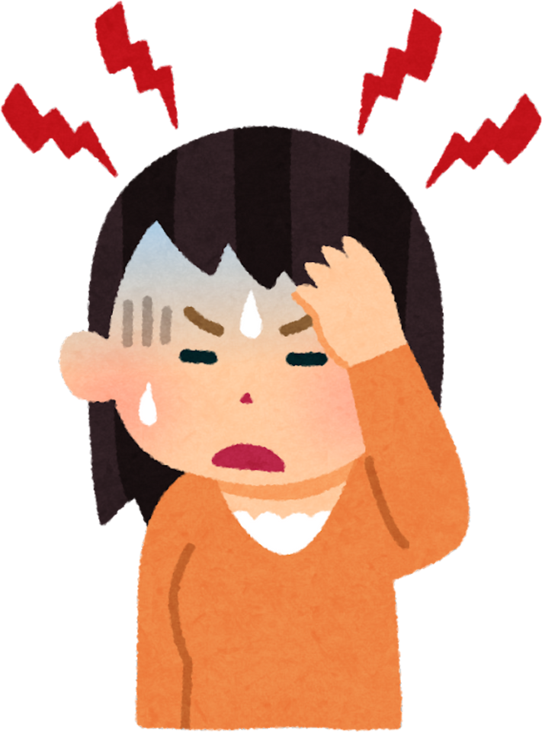
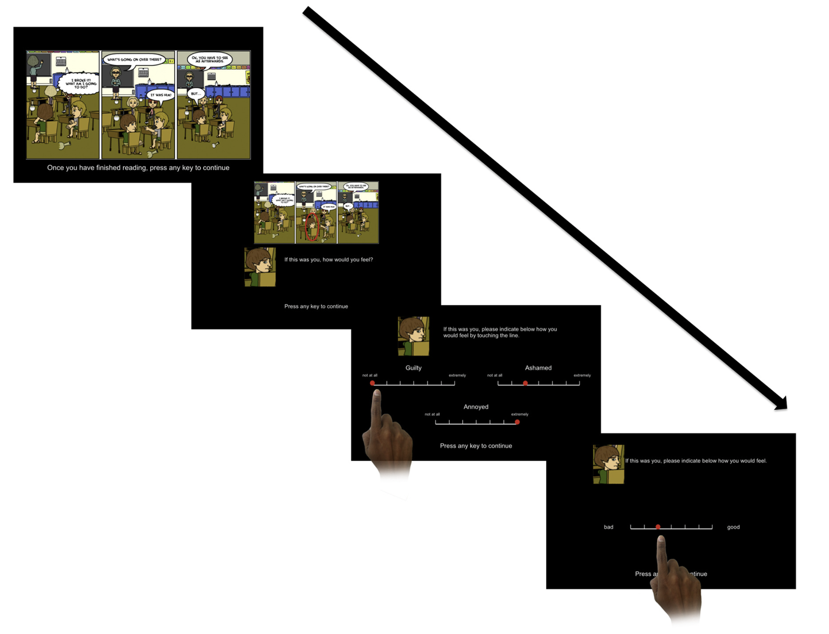
FINDINGS OF PREVIOUS STUDIES
Agency and Intentionality-Dependent Experiences of Moral Emotions (Bland et al., 2020)
UNINTENTIONAL
(accidental harm)
INTENTIONAL
(intended harm)
AGENT
commit the act
VICTIM
experience consequences
Examined evaluation of moral emotions (“guilt”, “shame”, “annoyance”, and “feeling bad”) from different perspectives as an AGENT or VICTIM whilst manipulating the intentionality in moral scenarios
Adopted task from EMOTICOM, a multidimensional constructed assessment of affective-cognitive function
Moral Emotion Task – EMOTICOM, Social Cognition
(Bland et al., 2016; 2020; Tangney et al., 2007)
Notes:
Natalia
Moral emotional experience do not only differ depending on an individual’s perspective of the moral scene, but also depending on individual differences in age, gender, and personality, resulting in different consequences on behaviour, as evident by previous studies on moral emotions.
This previous study was done to to examine moral emotions, specifically guilt, shame, annoyance, and feeling bad from two distinct viewpoints as an agent who committed the act and as a victim who experienced the consequences of the act on a moral scenario. The subjects were asked to assess their emotional responses upon the moral scenario is presented and make moral judgments based on the subjects’ emotional responses

Slide 8

FINDINGS OF PREVIOUS STUDIES
Agency and Intentionality-Dependent Experiences of Moral Emotions (Bland et al., 2020)
Individual’s perspective | Participants with role of agent (committed the act) feel greater levels of self-blaming emotions, shame and guilt Participants with role of victim (experienced the act) feel more annoynance
Gender difference | Female experienced heightened feelings of shame and guilt when being the agent
Personality difference | Guilt, shame and feeling bad were negatively correlated with psychoticism Heightened reactivity to negative emotional stimuli correlated with neuroticism
LIMITATIONS
Assess only a few moral emotions; unclear importance of others on modulating agency, intentionality, gender, and personality
Limited age range and number of participants in drawing a conclusion
Scenorios of task could only depict simplistic moral scenorios and unable to capture full complexity
(Bland et al., 2020)
Notes:
Natalia
Notably, the former researchers found significant differences in individual’s perspectives, gender and personality.
However, the scenarios of the behavioural task in the study were to simplistic and were not able to capture the full complexity of moral emotion and moral judgement.

Slide 9
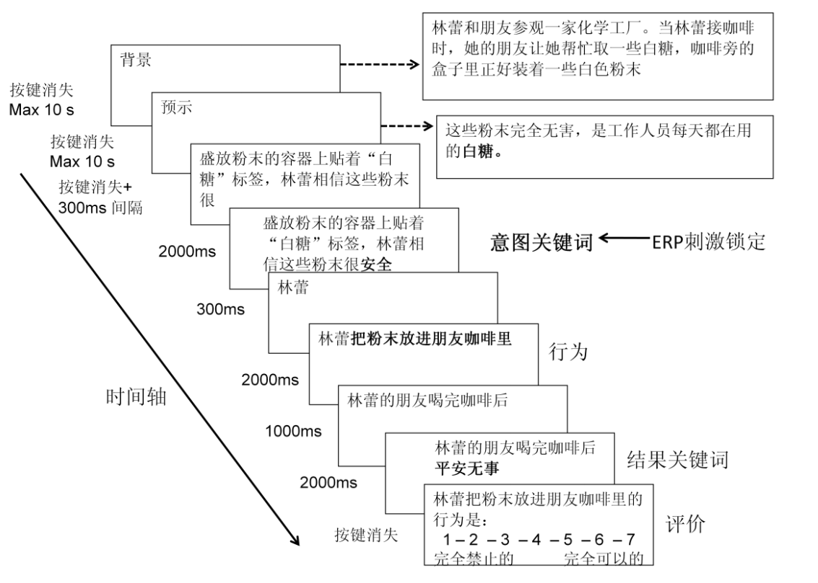
FINDINGS OF PREVIOUS STUDIES
经颅直流电刺激右侧颞顶联合区对道德意图加工的影响 – (Gan et al., 2013)
Exicting the Right Temporo-Parietal Junction with Transcranical Direct Current Stimulation Influences Moral Intention Processing
Investigate mental and neural mechanism of intention process under moral judgement context for harmful behaviors with ERP (event-related potential) and tDCS (transcranial direct current stimulation)
Behavioural task: evaluate 40 experimental moral scenarios selected from the Chinese version of ”Belief attribution and moral judgement of injurious behaviour” (1=“forbidden”; 7=“permissible”)
Text-form Moral Judgment Task
(Gan et al., 2013; Young et al., 2007)
Notes:
This study used ERP and tDCS to investigate the mental and neural mechanism of intention process under moral judgement context for harmful behaviors.
40 experimental moral scenarios were presented in text-form, each story of the scenario is divided into 4 parts: (1) background, (2) foreshadow, (3) belief and (4) outcome
After the subjects had read the background and foreshadow of the story, they were asked to judge the moral permissibility of the protagonist's action by rating on a scale of 1-7 ( 1 means "forbidden" and 7 means “permissible”).

Slide 10
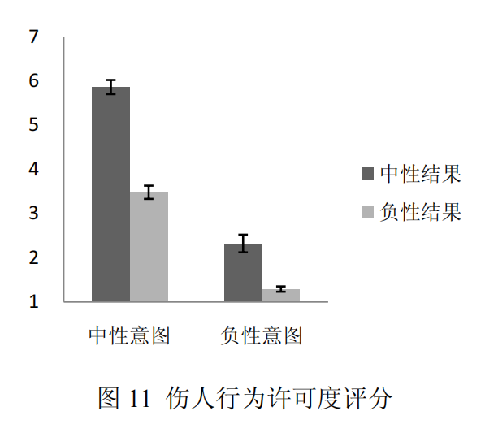
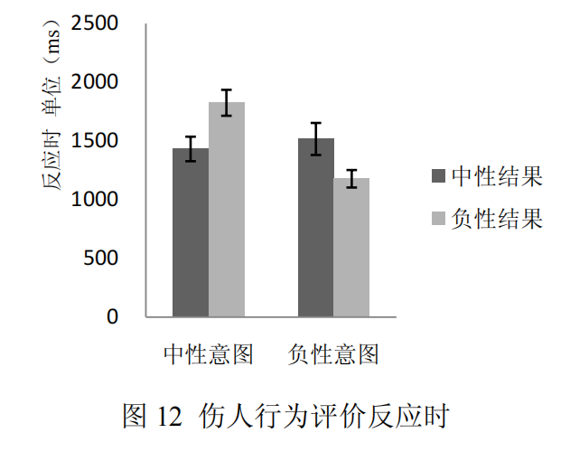
FINDINGS OF PREVIOUS STUDIES
经颅直流电刺激右侧颞顶联合区对道德意图加工的影响 – (Gan et al., 2013)
Exicting the Right Temporo-Parietal Junction with Transcranical Direct Current Stimulation Influences Moral Intention Processing
HYPOTHESIS
Results of Experiment 2
（无人受伤）
（无人受伤）
（伤人成功）
（伤人成功）
（无意伤人）
（有意伤人）
（无意伤人）
（有意伤人）
Significant main effect of intention and results – permissibility score of negative intention (results) is significantly lower than that of neutral intention (results). | Significant main effect of intention : reaction time of negative intention is significantly shorter than that of neutral intention
 | Non-significant main effect of results
Significant interaction between intention and outcome – difference in permissibility scores between attempted and successful harm was smaller than that between no harm and accidental harm | Significantly longer reaction time under incongruent condition of intention and outcome compared to that under congruent condition
(Gan et al., 2013)
Notes:
We chose to explain three of the moral judgement experiments on harmful behaviour
Experiment 2 - Examined the time course and brain mechanisms by which individuals process information about hurtful intentions and integrate relevant information in moral judgement tasks
The result of hurtful behaviour permissibility show that there are significant main effect
Bar chart on the right show the hurtful behaviour evaluation reaction time. that there are significant main effect

Slide 11

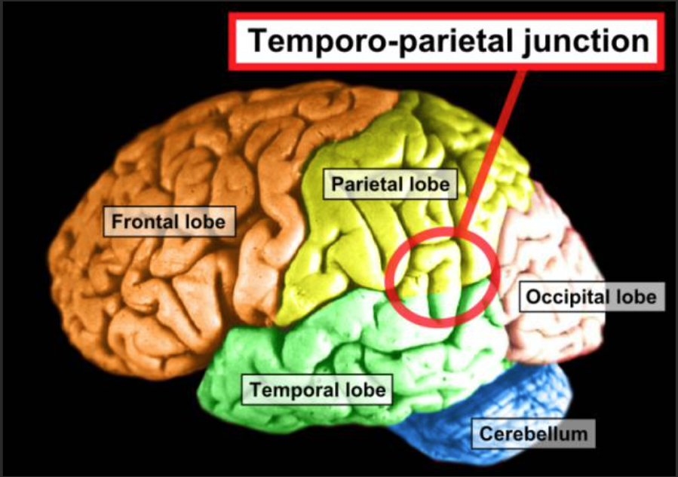
FINDINGS OF PREVIOUS STUDIES
2.2
Moral judgment task
Procedure of Experiment 4
HYPOTHESIS
Immediately
Examining the effect of tDCS cathodic stimulation to reduce RTPJ (right temporo-parietal junction) cortical excitability on the processing of moral judgement intentions for harmful behaviour
tDCS stimuli
Each subject received two tDCS stimuli (one cathodic stimulus and one sham stimulus) 1 week apart. In each experiment subjects completed an intention-outcome moral judgement task immediately after the stimulation.
1 week later
Immediately
Procedure of Experiment 7
sham
Same as experiment 4, but the tDCS cathodic stimuli was changed into anodal stimuli.
Brain regions-RTPJ
Research has shown that bilateral TPJ plays an unique role in perceiving the significance of human behaviours and mental states (Carter, Bowling, Reeck, & Huettel, 2012). However, comparing with LTPJ, RTPJ was highly activated when subjects processed information about mental states, and the intensity of BOLD signals in this brain region was significantly higher than when it process other nonrelated information (Perner, et al., 2006; Saxe & Kanwisher, 2003).
Notes:
For these two experiments aims to demonstrate that the tDCS intervention in the modified brain region is associated with behavioural changes in moral processing, thus demonstrating that the RTPJ is "causally related" to the processing of moral intentions.
关于为什么不选左侧：有研究发现左侧颞顶联合区（the left temporo-parietal junction，LTPJ）在加工非心理信息（如错误信号）的时候也有高度激活，

Slide 12
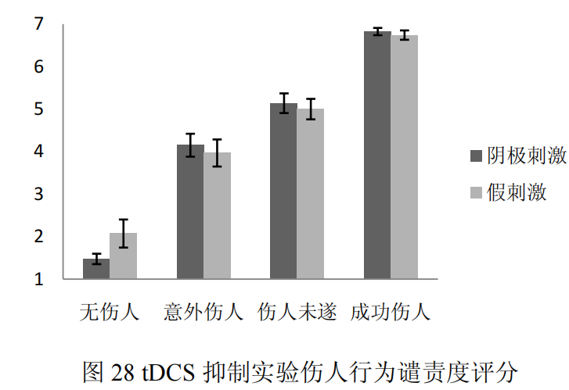
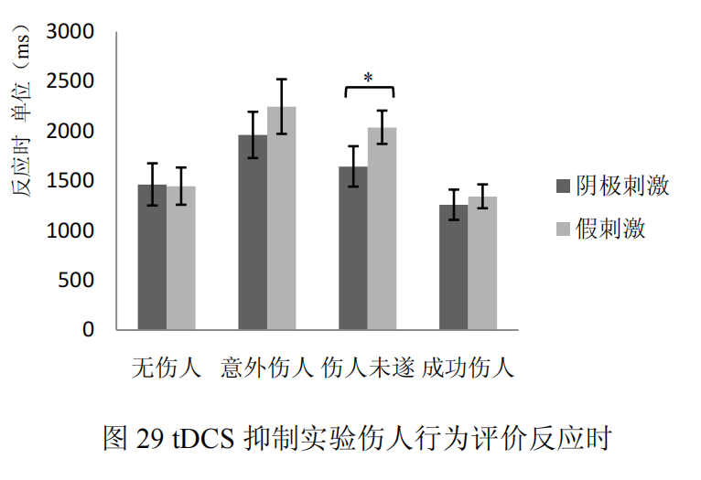
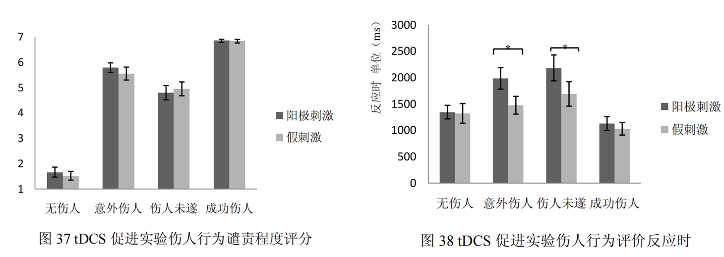
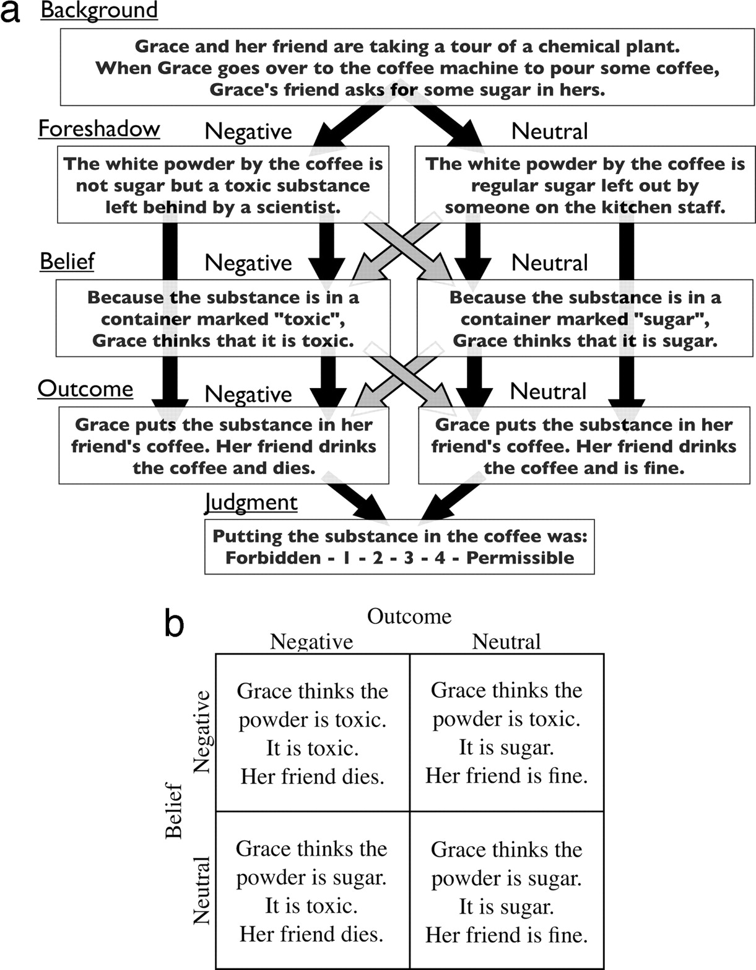
FINDINGS OF PREVIOUS STUDIES
2.2
Experiment 4 – CATHODIC
Experiment 7 – ANODAL
Significant main effect of intention and results: condemnation of negative intention (results) is significantly higher than that of neutral intention(results).
The remaining effects were not significant.
Interaction between intention & outcome:
shorter reaction time for negative results than neutral with negative intentions,
longer reaction time for negative results with neutral intentions
Interaction between tDCS & intention & outcome:
Under negative intention-neutral result condition, response time of cathodal stimulation is significantly shorter than that of sham stimulation.
Under other intention-result condition, no significant difference was found between cathodal and sham stimulation conditions.
The remaining main effects and interaction effects are not significant
tDCS cathodal stimulation leads to a significant shortening of reaction time of individuals making moral judgments, mainly reflected in the condition of attempted injury.
Significant main effect of intention (results): condemnation of negative intentions (results) is significantly higher than that of neutral intentions (results).
Significant interaction between intention & outcome: difference between neutral results and negative results under negative intentions is significantly smaller than that under neutral intentions.
The remaining effects were not significant.
Result is consistent with the behavioral results in Experiment 2,
tDCS anodal stimulation has no significant effect on the condemnation ratings made by individuals.
Significant main effect of results: reaction time for negative results is significantly shorter than the reaction time for neutral results
Significant interaction between intention & results: reaction time of negative results is significantly shorter than that of neutral results, and significantly longer under neutral intention
Significant interaction between tDCS & intention & outcome: response time of anode stimulation was significantly longer than the response time of sham stimulation under neutral intention-negative result and negative intention-neutral result conditions. No significant difference between conditions.
tDCS anodal stimulation causes individuals to significantly prolong the response time of making moral judgments, mainly reflected in the conditions of attempted injury and accidental injury where intention and result information conflict.
成功伤人
伤人未遂
意外伤人
无 伤人
(Gan et al., 2013)
Notes:
Due to the time I only explain the results high lighted in red.
先看实验四结果，图28表明。。
图29表明。。。
(左一)
意图主效应显著:负性意图的谴责度显著高于中性意图
结果主效应显著:负性结果的谴责度显著高于中性结果
其余效应都不显著。
(左二)
意图与结果的交互作用显著:
负性意图下，负性结果的反应时<中性结果
中性意图下，负性结果的反应时>中性结果。
tDCS与意图、结果的交互作用显著:
负性意图-中性结果条件下，阴极刺激反应时显著短于假刺激
而在中性意图-中性结果、中性意图-负性结果和负性意图-负性结果条件下，阴极刺激与假刺激条件无显著差异
其余主效应和交互效应都不显著
该结果表明 tDCS 阴极刺激导致个体做出道德判断的反应时显著缩短，且主要体现在伤人未遂条件下。
(右一)
意图主效应显著:
负性意图的谴责度显著高于中性意图，
结果主效应显著:
负性结果的谴责度显著高于中性结果
意图与结果的交互作用显著:
负性意图下中性结果与负性结果的差异显著小于中性意图下中性结果与负性结果的差异。
其余效应都不显著。
此结果与实验二的行为结果趋势一致，同时也表明 tDCS 阳极刺激对个体所做出的谴责度评分没有显著影响。
(右二)
结果主效应显著:
负性结果的反应时显著短于中性结果的反应时；
意图与结果的交互作用显著:
负性结果的反应时显著短于中性结果，而在中性意图下，负性结果的反应时显著长于中性结果；
tDCS 与意图、结果的交互作用显著：
中性意图负性结果和负性意图中性结果条件下，阳极刺激反应时显著长于假刺激反应时，而在中性意图中性结果和负性意图负性结果条件下，阳极刺激与假刺激条件无显著差异；
tDCS 阳极刺激导致个体做出道德判断的反应时显著延长，且主要体现在意图和结果信息相冲突的伤人未遂和意外伤人条件下。

Slide 13
FINDINGS OF PREVIOUS STUDIES
经颅直流电刺激右侧颞顶联合区对道德意图加工的影响 – (Gan et al., 2013)
Exicting the Right Temporo-Parietal Junction with Transcranical Direct Current Stimulation Influences Moral Intention Processing
LIMITATIONS
This study found that tDCS anode as well as cathodic stimulation at RTPJ can induce the same changes in individual when doing moral judgment task, but this effect is mainly reflected in the response time instead of moral permissibility score.
The study only investigate the cortical excitability modulated by tDCS at RTPJ. But this brain area is not the only place where moral judgement intentions are processed. Moral judgement is the result of integrated processing and coordinated action of multiple brain regions.
The research only examined negative, and neutral intentions in intention processing, but did not correlate the moral emotion with the moral judgment task.
(Gan et al., 2013)
Notes:
Limitations of the research:

Slide 14
Proposed Question
one
Previous studies only showed significant differences in the response time of the injurious behavior evaluation after stimulation by tDCS, but no difference in the evaluation permissibility.
Content of the story might be too extreme; the negative consequences involve death.
With general moral judgment, actions that cause death are not acceptable
Negative part of the paradigm would be changed to non-death related events, expecting greater differences to be observed in the moral permissibility of hurtful behavior.
two
Further exploration in the right prefrontal cortex area as a region related to moral processing by observing the changes in the response time for evaluation of injurious behavior and evaluation permissibility after the application of tDCS
three
Moral emotional evaluation will be added as an important component of the moral judgment system, which might have significant impact on an individual's moral judgment processing.
Notes:
Therefor we proposed three questions
X
We speculate that
√therefor we tend to do some changes of the paradigm.
2
3

Slide 15
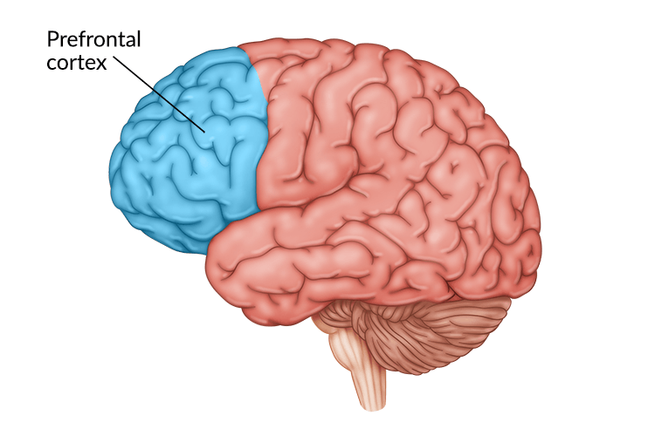
BRAIN AREA OF INTEREST
The Prefrontal Cortex (PFC)
A multimodal area where information from various sensory modalities is integrated to form physiologic constructs of memory, perception, and diverse cognitive processes
Regulates thoughts, actions and emotions through extensive connections with other brain areas
As a crucial brain region for moral judgment intention processing
Previous literature had revealed PFC is highly related to executive control, complex emotional processing, etc.
Thus, PFC are significantly activated and play a very important role in the processing of advanced social situations (such as moral judgment and economic decision-making)
(Arnsten, 2009; Etkin, Egner, & Kalisch, 2011; Mitchell, Banaji, & Macrae, 2005; Siddiqui et al., 2008; Warbuton & Brown, 2010)
Notes:
The prefrontal cortex is a vital brain region for the processing of moral judgement intentions.
Extensive research has demonstrated its close association with executive control and complex emotional processing, and in the processing of advanced social situations

Slide 16

METHODOLOGY
Pariticipants & Experimental Settings
Inclusion Criteria for Recruitment
Healthy volunteers of age 18 or above Right-handed No self-reported previous or current psychiatric or neurological disorders, no significant head injury, and no current use of medication known to affect mood or cognition No habitual smoking or drinking
Volunteers will be informed of the study’s purpose, personal information to be collected and their right to withdraw at any time prior to the beginning of the study (consent)
6 participants
(3 males & 3 females)
are needed!
(Bland et al., 2016)

Slide 17
METHODOLOGY
1. Change intentions and consequences to be less severe.
情节1：林蕾和朋友参观一家化学工厂。当林蕾接咖啡时，她的朋友让她帮忙取一些白糖。咖啡旁的盒子里正好装着一些白色粉末。
这些粉末是一个科学家留下来的致命毒药 泻药。
盛放粉末的容器上贴着“有毒 泻药”标签，林蕾相信这些粉末很危险 能让人拉肚子。
林蕾把粉末放进朋友咖啡里。林蕾的朋友喝完咖啡后中毒而死 拉了肚子。
情节2：何伟带着一个客人参观实验室。实验室所有病毒都被装在一个密封装置里。这个密封装置的开关坏了，修理工人刚赶过来维修。
开关仍然是坏的，病毒暴露在空气中。因此进入这个房间的任何人都会感染病毒致死 发烧。
何伟相信开关是坏的。
何伟让客人进入实验室。客人中毒而死 发烧。
情节3：丁怡和她的邻居在海上玩皮划艇，这片海域里有很多水母。丁怡的邻居打算下海游泳。
因为海里的水母会蜇人，被蛰的人会有生命危险 感到疼痛，所以下去游泳很 有点危险。
丁怡相信这些水母致命 会让人疼痛。
丁怡让邻居下海游泳。邻居被蛰身亡 感到疼痛。
Notes:
Previous studies have only found differences in response times but not in scores, perhaps it is because the intentions and consequences in the materials are too serious. So we want to change the intentions and consequences to be less severe in our study.
Examples are shown on the screen.

Slide 18
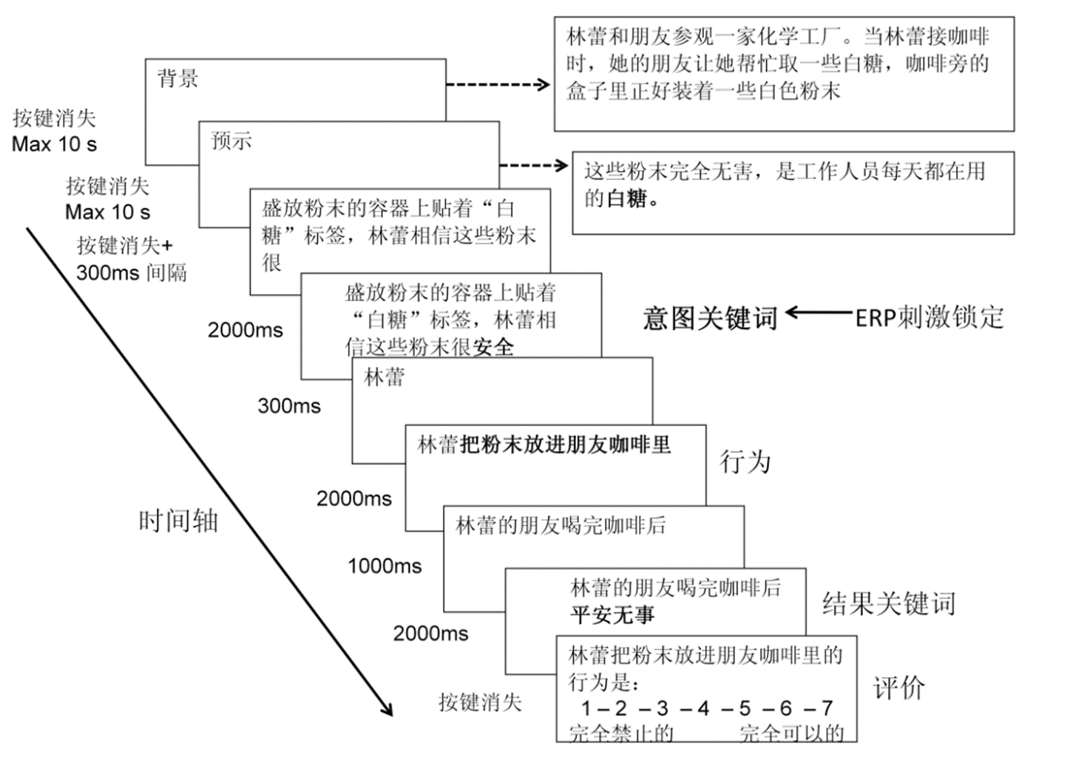
METHODOLOGY
2. Add emotional ratings of anger, disgust, happiness and willingness to punish.
Within-subjects design:
2 (tDCS stimulation: anodal stimulation, sham stimulation) × 2 (intention: negative, neutral) × 2 (consequence: negative, neutral)
Pre-experiment
(4 Trials)
The Positive and Negative Affect Scale (PANAS)
Formal Experiment
(40 Trials)
Anodal/Sham Stimulation
The first experiment
你感受到的厌恶程度是：
1 - 2 - 3 - 4 - 5 - 6 – 7
一点也不厌恶 非常厌恶
Pre-experiment
(4 Trials)
The Positive and Negative Affect Scale (PANAS)
Formal Experiment
(40 Trials)
Sham/Anodal Stimulation
你感受到的愤怒程度是：
1 - 2 - 3 - 4 - 5 - 6 – 7
一点也不愤怒 非常愤怒
情绪
The second experiment
(1 week later)
你感受到的快乐程度是：
1 - 2 - 3 - 4 - 5 - 6 – 7
一点也不快乐 非常快乐
林蕾把粉末放进朋友咖啡里的行为是：
1 - 2 – 3 – 4 – 5 – 6 - 7
完全禁止的 完全可以的
评价
你认为应该给林蕾多重的惩罚：
1 - 2 – 3 – 4 – 5 – 6 - 7
完全不需要惩罚 非常重的惩罚
惩罚意愿
Notes:
What’s more, we plan to add emotional ratings of anger, disgust, happiness and willingness to punish.
点！Our study is a within-subjects design. So each participant will receive two tDCS stimulations (an anodal stimulation and a sham stimulation,1 week apart, and the order was counterbalanced across participants.
点！In each experiment, after completing The Positive and Negative Affect Scale, participants will have anodal or sham stimulation, and then have a moral judgment task immediately. The task included a pre-experiment and a formal experiment. The formal experiment consists of 40 trials lasting about 30 minutes.
点！This is the original trial structure of the previous study. In the scoring process, in addition to the moral permissibility score, we add emotional ratings of anger, disgust, happiness and willingness to punish.
According to the international EEG 10/20 system, the anode electrode will be placed at F6, and the cathode electrode will be placed at Fp1. The current will be constant and of 2 mA in intensity, with a 30 s ramp up and down. For sham stimulation, the procedures will be the same, but the stimulation will be turned off after 30 seconds without the participants’ knowledge. The participants may have felt the initial itching, but there will be no current for the rest of the stimulation.

Slide 19
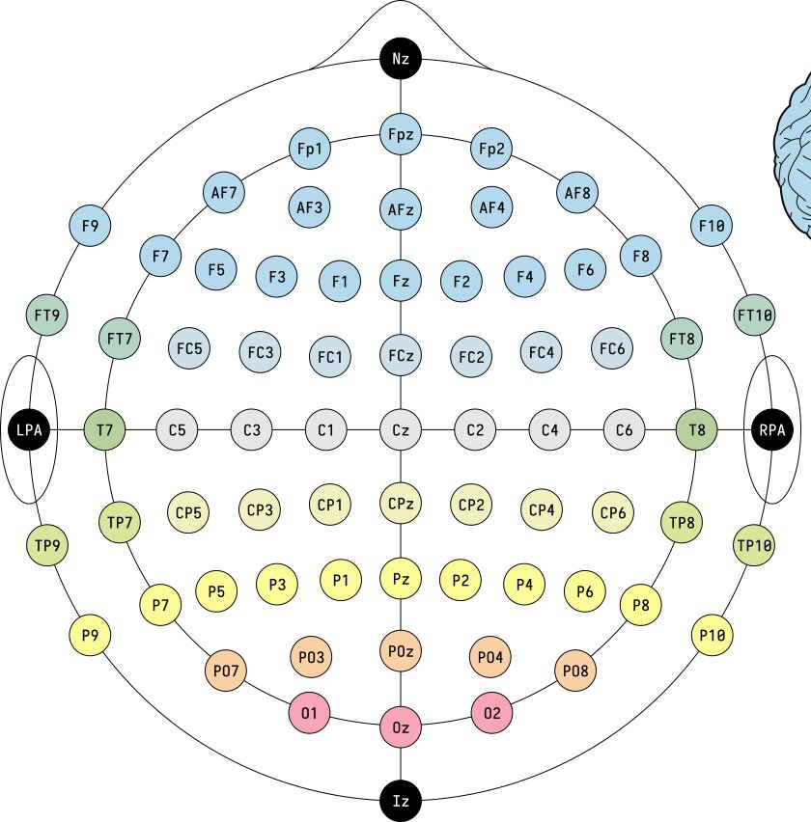
METHODOLOGY
3. Activate the right ventrolateral prefrontal cortex (RVLPFC) to reduce the intensity of people's experiences of socially negative emotions.
According to the international EEG 10/20 system, the anode electrode will be placed at F6, and the cathode electrode will be placed at Fp1. The current will be constant and of 1.5 mA in intensity, with a 30-second ramp up and down.
For sham stimulation, the procedures will be the same, but the stimulation will be turned off after 30 seconds without the participants’ knowledge. The participants may have felt the initial itching, but there will be no current for the rest of the stimulation.
Notes:
As we’ve mentioned before, the brain area of interest for our study is the ventrolateral prefrontal cortex, because the ventrolateral prefrontal cortex is the core area of emotion regulation, especially in the down-regulation of negative emotions. So we plan to activate the right ventrolateral prefrontal cortex to reduce the intensity of people's experiences of negative emotions.
According to the international EEG 10/20 system, the anode (诶no的) electrode will be placed at F6, and the cathode (凯so的) electrode will be placed at Fp1. The current will be constant and of 1.5 milli-am-peres in intensity, with a 30–second ramp up and down.
For sham stimulation, the procedures will be the same, but the stimulation will be turned off after 30 seconds without the participants’ knowledge. The participants may have felt the initial itching, but there will be no current for the rest of the stimulation.

Slide 20
EXPECTED RESULTS
1. No significant difference will be found in the participants' scores on PANAS before the two experiments.
2. Ratings of anger, disgust, happiness:
Anger/Disgust
Happiness
Notes:
First of all, we expect no difference will be found in the participants' scores on The Positive and Negative Affect Scale before the two experiments.
And the results of ratings of anger, disgust and happiness may be like this. We expect that, in accidental harm, attempted harm and successful harm conditions, anodal stimulation will tend to increase the ratings of anger and disgust. Because we won’t have many participants, we certainly can’t say there will be a significant difference. We also expect no difference will be found in the participants' scores on happiness.

Slide 21
EXPECTED RESULTS
3. Moral permissibility and willingness to punish:
Moral permissibility
Willingness to punish
Notes:
During anodal stimulation, the moral permissibility may tend to increase, and the willingness to punish may tend to decrease.

Slide 22
SCHEDULE
3/26-3/31
Materials modification and program design
4/15-4/20
Data analysis
4/20-4/28
Result reporting
4/1-4/14
Participants recruitment and data collection
Notes:
This is our schedule.

Slide 23
References
Arnsten, A. F. T. (2009). Stress signalling pathways that impair prefrontal cortex structure and function. Nature Reviews Neuroscience, 10(6), 410-422. https://doi.org/10.1038/nrn2648
Bland, A. R., Roiser, J. P., Mehta, M. A., Schei, T., Boland, H., Campbell-Meiklejohn, D. K., Emsley, R. A., Munafo, M. R., Penton-Voak, I. S., Seara-Cardoso, A., Viding, E., Voon, V., Sahakian, B. J., Robbins, T. W., & Elliot, R. (2016). Emoticom: a neuropsychological test battery to evaluate emotion, motivation, impulsivity, and social cognition. Frontiers in Behavioral Neuroscience, 10(25). https://doi.org/10.3389/fnbeh.2016.00025
Bland, A. R., Schei, T., Roiser, J. P., Mehta, M. A., Zahn, R., Seara-Cardoso, A., Viding, E., Sahakian, B. J., Robbins, T. W., & Elliott, R. (2020). Agency and intentionally-dependent expreiences of moral emotions. Personality and Individual Differences, 164, 110125. https://doi.org/10.1016/j.paid.2020.110125
Carter, R. M., Bowling, D. L., Reeck, C., & Huettel, S. A. (2012). A distinct role of the temporal-parietal junction in predicting socially guided decisions. Science, 337(6090), 109-111. https://doi.org/10.1126/science.1219681
Darwin, C. (1872/1965). The Expression of the Emotions in Man and Animals. Chicago, IL: University of Chicago.
Etkin, A., Egner, T., & Kalisch, R. (2011). Emotional preocessing in anterior cingulate and medial prefrontla cortex. Trends in Cognitive Sciences, 15(2), 85-93. https://doi.org/10.1016/j.tics.2010.11.004
Gan, T., Li, W., Tang, H., Lu, X., Li, X., Liu, C., & Luo, Y. (2013). Exciting the right temporo-parietal junction with transcranial direct current stimulation influences moral intention processing. Acta Psychologica Sinica, 45(9), 1009-1014.
Jin, W.,& Peng, M. (2021). The effects of social perception on moral judgement. Frontiers in Psychology, 11, 557216. https:..doi.org/10.3389/fpsyg.2020.557216
Mitchell, J. P., Banaji, M. R., & Macrae, C. N. (2005). The link between social cognition and self-referential thought in the medial prefrontal cortex. Journal of Cognitive Neuroscience, 17(8), 1306-1315. https://doi.org/10.1162/0898929055002418
Pohling, R., Diessner, R., & Strobel, A. (2018). The role of gratitude and moral elevation in moral identity development. Internation of Behavioral Development, 42(2), 405-415. https://doi.org/10.1177/0165025417727874
Siddiqui, S. V., Chatterjee, U., Kumar, D., Siddiqui, A., & Goyal, N. (2008). Neuropsychology of prefrontal cortex. Indian Journal of Psychiatry, 50(3), 202-208. https://10.4103/0019-5545.43634
Tangney, J. P., Stuewig, J., & Mashek, D. J. (2007). Moral emotions and moral behavior. Annual Review of Psychology, 58, 345-372. https://doi.org/10.1146/annurev.psych.56.091103.070145
Van de Vyver, J., & Abrams, D. (2017). Is moral elevation an approach-oriented emotion? The Journal of Positive Psychology, 12(2), 178-185. https://doi.org/10.1080/17439760.2016.1163410
Warburton, E. C., & Brown, M. W. (2010). Findings from animals concerning when interactions between perirhinal cortex, hippocampus and medial prefrontal cortex are necessary for recognition memory. Neuropsychologia, 48(8), 2262-2272. https://doi.org/10.1016/j.neuropsychologica.2009.12.022
Young, L., Cushman, F., Hauser, M., & Saxe, R. (2007). The neural basis of the interaction between theory of mind and moral judgment. Proceedings of the National Academy of Sciences, 104(20), 8235-8240.

